Slide 1


PRESENTATION ON INDUSTRIAL TRAINING EVALUATION
“Web development”
SUBMITTED BY:
Abhishek Majumder (B200037CS)
Mohan Tanti (B200064CS)
B.Tech 4th Year
Department of Computer Science and Engineering
NIT Sikkim

Slide 2

OUTLINE
ACKNOWLEDGEMENT
ABOUT MICROZENSYS SOLUTION
INTRODUCTION
TECHNOLOGY USED
OUR WORK
EXPERIENCE GAIN
CONCLUSION
CERTIFICATE OF COMPLETION
LETTER OF RECOMMENDATION

Slide 3
ACKNOWLEDGEMENT
The successful completion of this internship would not have been possible without the support and assistance of many individuals and organizations. We feel immensely blessed to have gotten this during the course of my internship program. We would like to take this opportunity to offer my earnest admiration for each and every one of them.
We would like to express my gratitude to Mr. Rakesh sir, who has been a constant source of inspiration as my intern trainer. Without their constant guidance and suggestions, our project would have been nowhere near completion. My gratitude for their trust and generosity goes beyond words.
Finally, we thank all my teachers, who were the ones who prepared us for this endeavour.

Slide 4
ABOUT MICROZENSYS SOLUTIONS
Microzensys solution, is a global Solution consulting headquartered in Hyderabad India.
Microzensys is a global Solution consulting firm that helps clients implement processes and disciplines to drive sustained revenue acceleration. The app needed to have user friendly approach.
Microzensys use a holistic, science-based approach combining training, consulting, coaching, and diagnostics to help you get the results you want.

Slide 5
INTRODUCTION
Web development is the process of creating, building and maintaining websites and web applications. It also include web design, web programming and database management.
Web development is of two type one is Frontend Development and second is Backend Development.
Frontend development stands as the foundation of user interaction and experience on the web.
It encompasses the creative fusion of design and functionality, crafting the visual and interactive elements users engage with daily.
From the layout and aesthetics to the seamless functionality of websites and applications, frontend development bridges the gap between user expectations and technological innovation.

Slide 6
USED TECHNOLOGIES
HTML
CSS
BOOTSTRAP
JAVASCRIPT
REACTJS
FIGMA

Slide 7
BRIEF IDEA ON TOOLS
HTML stands for Hypertext Markup Language. Hypertext refer to system of organizing and linking text, images, and other multimedia resources. Markup means structuring.
CSS stands for Cascading Style Sheets. It describes how Html elements are to be displayed on screen, paper or in other media.
JavaScript in mainly used for enhancing the interactivity and dynamic behaviour of web pages.
React is a JavaScript library for building user interfaces. It is used to build single page applications and allows us to create reusable UI components.

Slide 8
OUR WORK
Our role at Microzensys was as a frontend developer. We work directly with development department and work as a team with other interns.
Where we work on different websites like PrimeHRM, PrimeGYM, Medizensys to make user interactive interface.
Our daily tasks include :
Every week, we had a meeting with our mentor of what we have done and discuss about the project's status.
Writing and reviewing the code for a particular module.

Slide 9
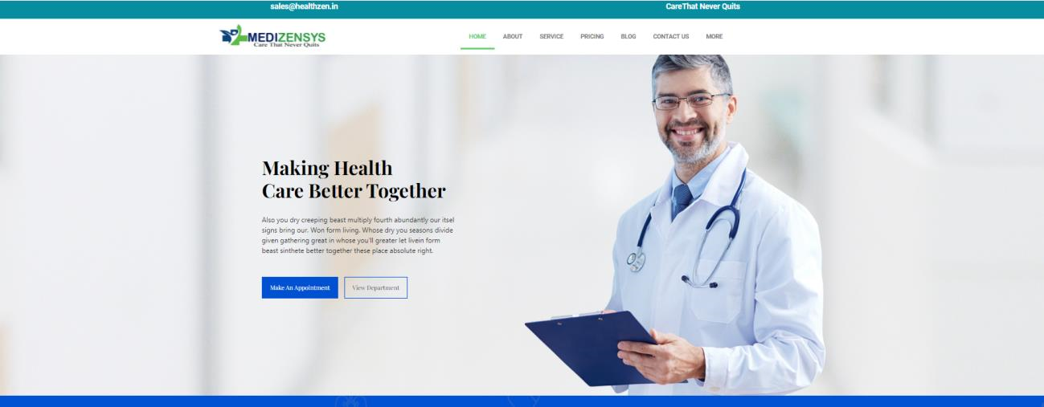
SCREENSHOT

Slide 10
SCREENSHOT
Associate Professor
Associate Professor

Slide 11
EXPERIENCE
During our internship with Microzensys, We were able to develop our problem-solving, active listening and planning skills.
And we were able to learn to work with technologies such as html, CSS, JavaScript and ReactJS.
We were able to apply these skills in projects, which aided our development.
The work was challenging, but it helped us improve our skills and gain more confidence in ourself. It was a valuable experience.

Slide 12
CONCLUSION
Finally, we can claim that this internship helps us gain experience. Thanks to Microzensys, We gained so much more in-depth knowledge of technical skills and personal skills.
This project helped us gather theoretical and practical knowledge about HTML, CSS, JavaScript and other programming languages. Now we are confident and competent in frontend.
Our internship company gave us a good scope to learn and discover my potential. We are very grateful to them.
Now we are able to develop web applications. We were fortunate to get the chance to meet the real-life software development environment.

Slide 13
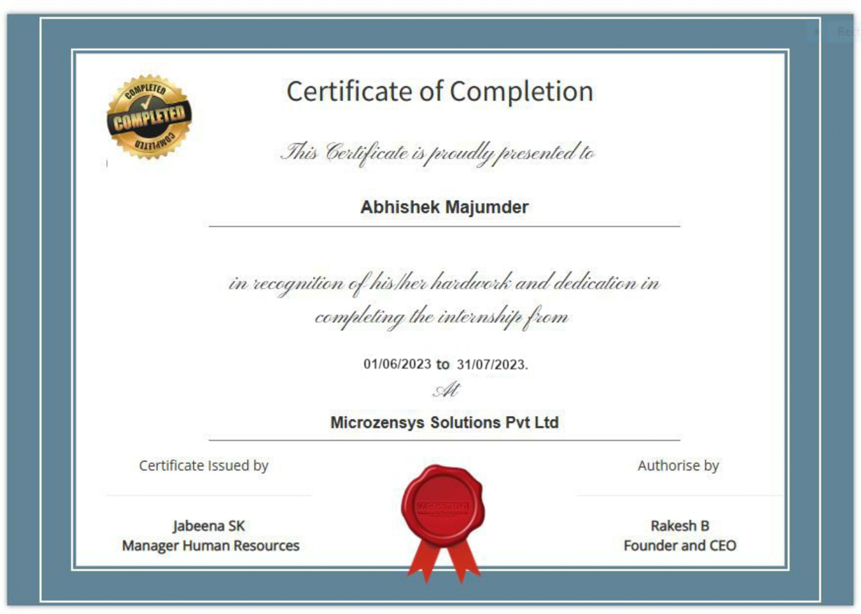
CERTIFICATE OF COMPLETION

Slide 14
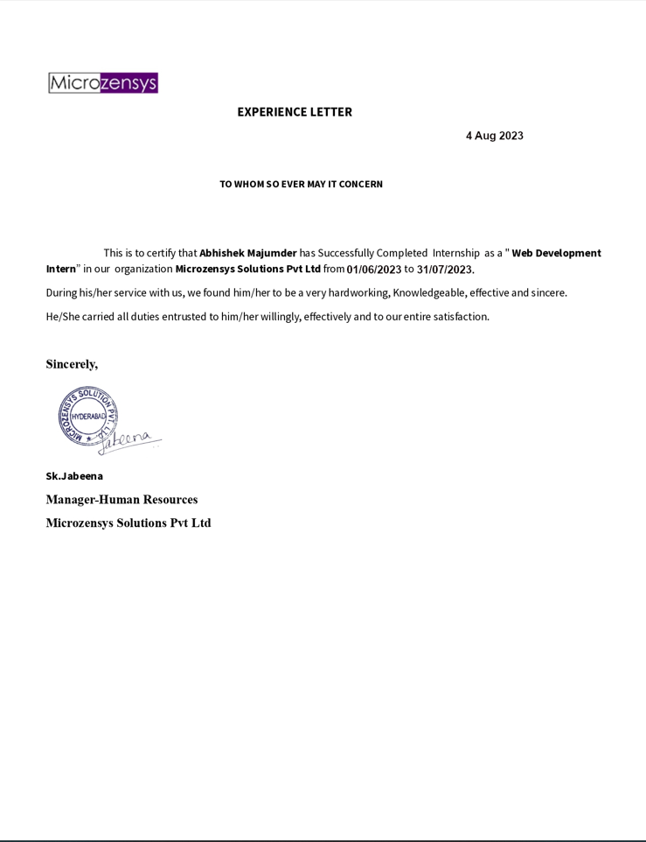
LETTER OF RECOMMENDATION

Slide 15
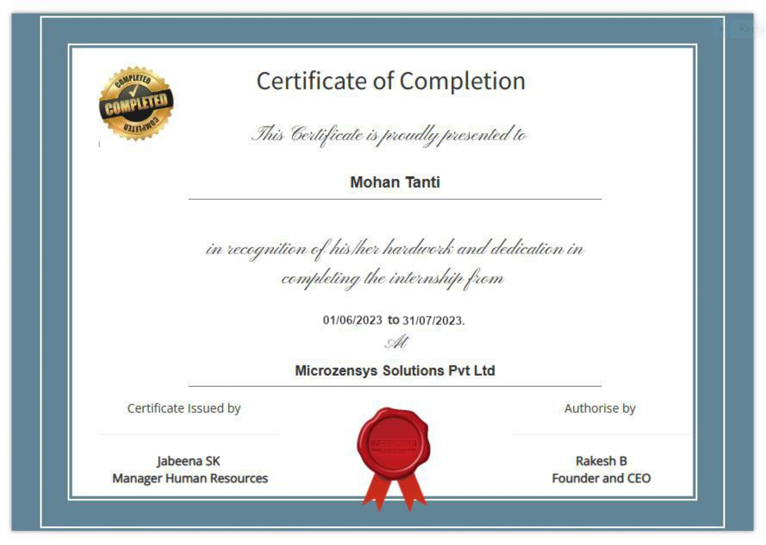
CERTIFICATE OF COMPLETION

Slide 16
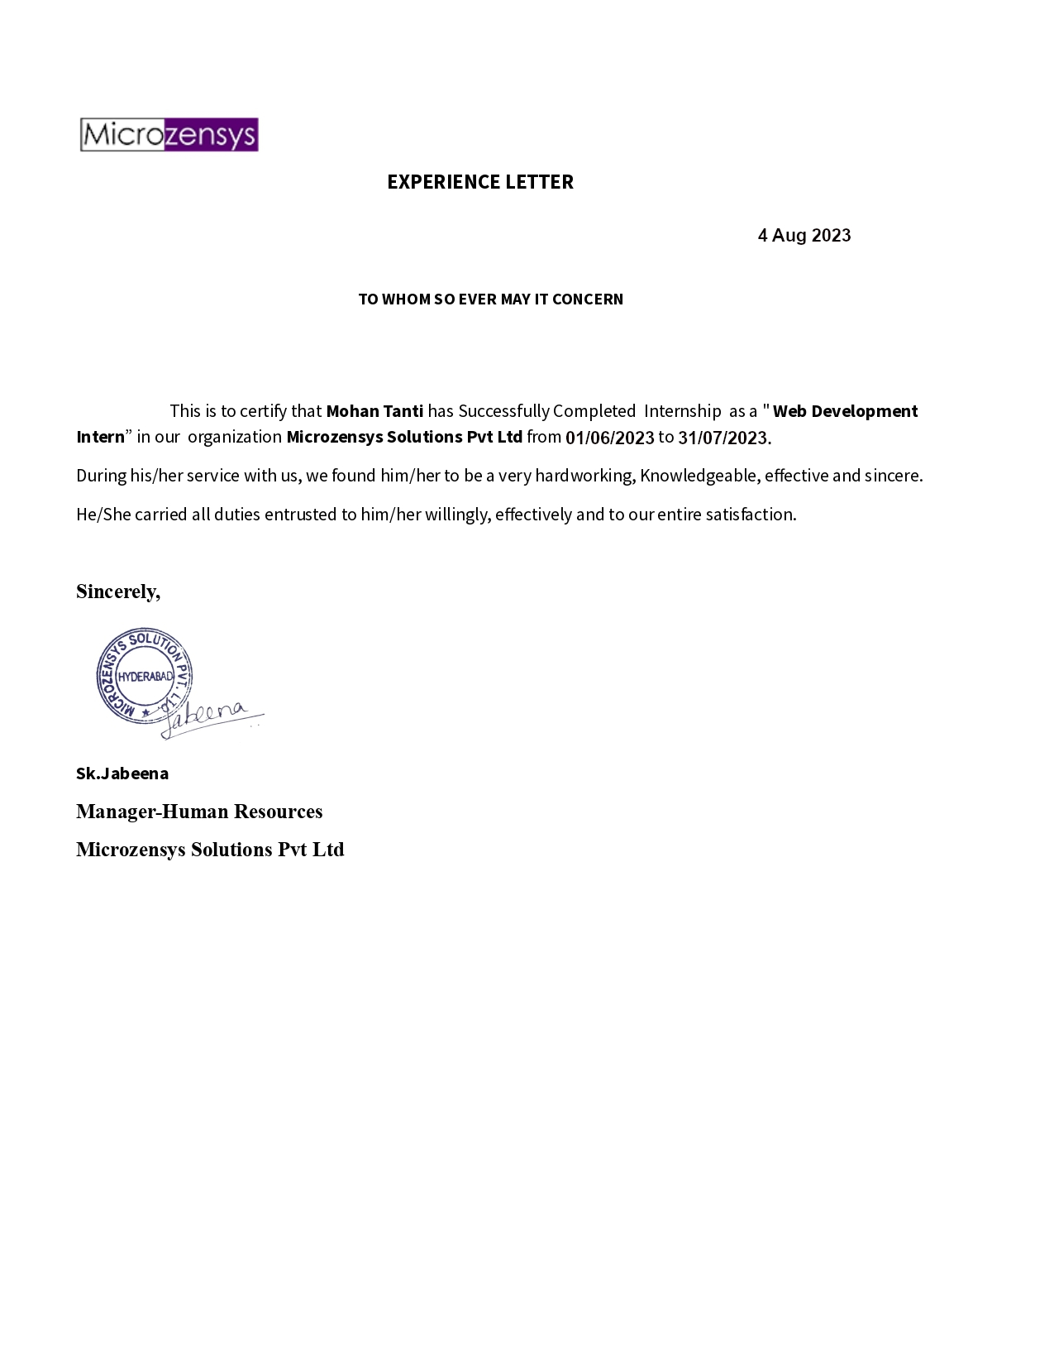
LETTER OF RECOMMENDATION

Slide 17
THANK YOU

